Slide 1
IMPACT OF GST NOTICES ON INCOME TAX [An Overview]

Slide 2
Why do people issue Fake Invoices?
encashment of input tax credit;
Reducing/inflating turnovers;
money laundering; etc.
To avail unfair advantages like fraudulent availing of the input tax credit;

Slide 3
Penalties under Income tax Act – Fake billing
1
270A- Penalty for under-reporting and misreporting of income
2
271AAC- Penalty in respect of certain income
3
271AAD- Penalty for false entry, fake invoices etc. in books of account
4
276C- Wilful attempt to evade tax
5
277- False statement in verification, etc.
4
6
277A- Falsification of books of account or document, etc.
7
278- Abatement of false return, etc.

Slide 4
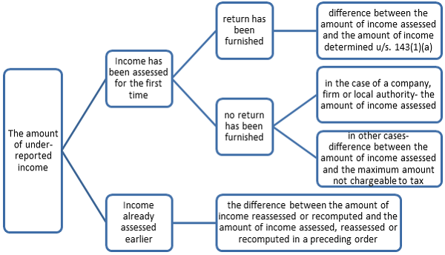
Section 270A of Income Tax Act
Under reporting under section 270A(2)

Slide 5
Section 270A of Income Tax Act
Misreporting under section 270A(8)
misrepresentation or suppression of facts;
failure to record investments in the books of account;
claim of expenditure not substantiated by any evidence;
recording of any false entry in the books of account;
failure to record any receipt in books of account having a bearing on total income; and
failure to report any international transaction or any transaction deemed to be an international transaction or any specified domestic transaction, to which the provisions of Chapter X apply.

Slide 6
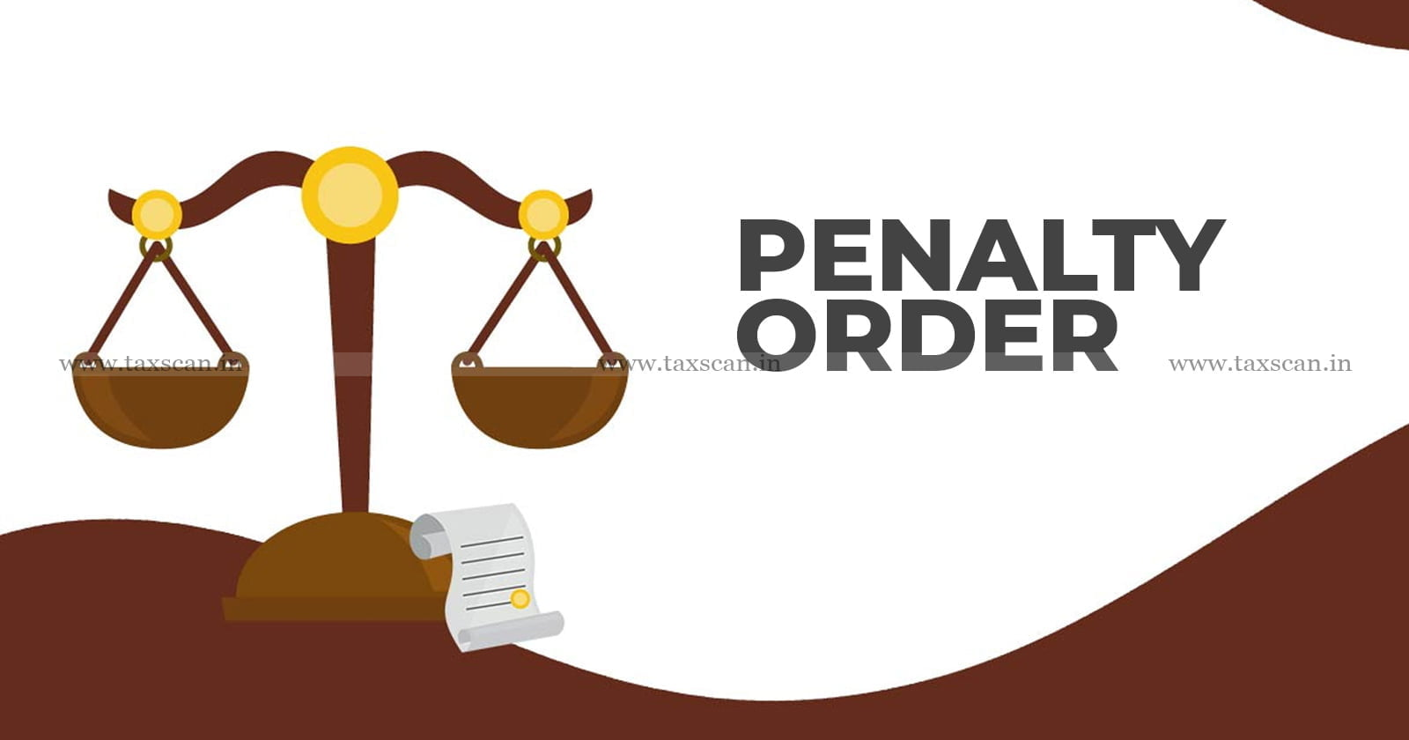
Section 270A of Income Tax Act
Penalties
Underreporting
u/s 270A(7)
Misreportingu/s 270A(8)
50% of the amount of tax payable on under reported income.
200% of the amount of tax payable on under reported income.

Slide 7
Section 270A of Income Tax Act
Tax payable in respect of the under-reported income u/s 270A(10)
Tax Payable in respect of Under-reported Income
Where no return of income has been furnished and the income has been assessed for the first time:- the amount of tax calculated on the under-reported income as increased by the maximum amount not chargeable to tax as if it were the total income.
In other case determined as per the formula (X-Y)
where the total income determined u/s 143(1)(a) or assessed, reassessed or recomputed in a preceding order is a loss, the amount of tax calculated on the under-reported income as if it were the total income
X – amount of tax calculated on the under-reported income as increased by the total income determined u/s 143(1)(a) or assessed, reassessed or recomputed in the preceding order as if it were the total income and
Y - amount of tax calculated on the total income determined u/s 143(1)(a) or assessed, reassessed or recomputed in the preceding order

Slide 8
Section 271 AAC of Income Tax Act
Penalty in respect of certain income
Where the income determined includes any income referred to in section 68, section 69, section 69A, section 69B, section 69C or section 69D, the assessee shall pay a penalty, in addition to tax payable under section 115BBE.
unexplained expenditure deemed to be the income of the assessee
Tax on income referred to in section 68 or section 69 or section 69A or section 69B or section 69C or section 69D
A penalty at the rate of ten per cent of the tax payable under clause (i) of sub-section (1) of section 115BBE
The amount of income-tax on income referred to in section 68, section 69, section 69A, section 69B, section 69C or section 69D shall be calculated at the rate of sixty percent

Slide 9
Section 271 AAC of Income Tax Act
1st proviso to 271AAC(1)- No penalty in the discussed sections to the extent such income has been included in the return of income and the tax in accordance section 115BBE(1)(i) has been paid on or before the end of the relevant previous year.
Sec 271AAC(2)- No penalty under the provisions of Section 270A shall be imposed upon the assesse in respect of the income referred to in sub-section (1).
Effective rate of Tax (with penalty) w.r.t addition u/s 68 to 69D= 84% (60% +25% + 4%)+ 6% ( Penalty of 10% of 60)

Slide 10
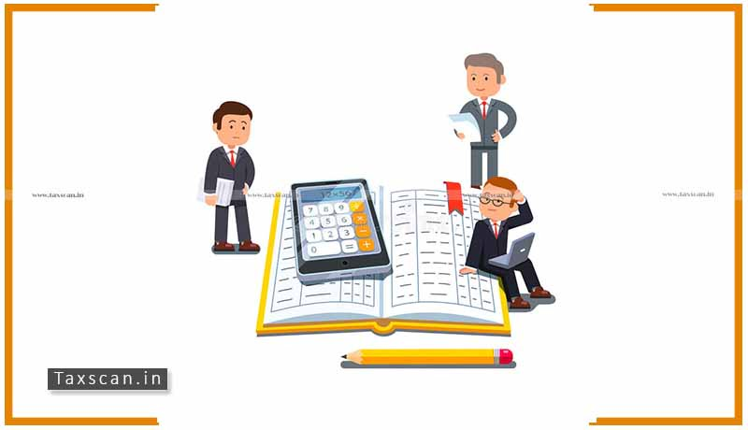
Section 271 AAD of Income Tax Act
Penalty for false entry, fake invoices etc. in books of account
If any assessing officer finds
a) A false entry
b) An omission of any entry which is relevant for computation of total income of an assessee.
He may direct the assessee to pay a penalty of an amount equal to sum of such false or omitted entries.

Slide 11
Section 271 AAD of Income Tax Act
The false entry here means the following:
Forged or false document such as a fake invoice
Any invoice of supply or receipts of goods or services issued by any person without actual supply or receipt of goods or services
An invoice in respect of supply or receipt of goods or services or both to or from a person who does not exist

Slide 12
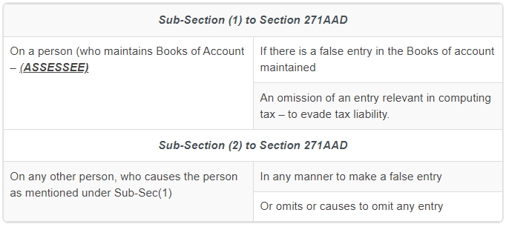
Section 271 AAD of Income Tax Act
On a plain reading of this section (supra), it is very clear that the penalty is imposed on 2 different persons as stated below;
Penalty equivalent to a sum equal to the aggregate amount of such false entry or omitted entry is levied.

Slide 13
Section 276C of Income Tax Act
Wilful attempt to evade tax, etc.
276C(1)
Wilful attempt to evade tax, penalty or interest
276C(2)
Wilful attempt to evade the payment of tax, penalty or interest
Amount of Tax evasion sought
<=25 Lakhs
Amount of Tax evasion sought
>25 Lakhs
Punishment of Rigorous Imprisonment
Varying from 3 months to 2 years
Punishment of Rigorous Imprisonment
Varying from 6 months to 7 years along with fine
Punishment of Rigorous Imprisonment
Varying from 3 months to 2 years

Slide 14
Section 276C of Income Tax Act
What is wilful attempt to evade any tax, penalty or interest chargeable under the Act ?
Where any person:
Has possession of any books of account or other documents containing a false entry
Makes or causes to be made any false entry in such books of accounts
Wilfully omits or causes to be omitted any relevant entry in such books of accounts
Enables any other person to evade any tax, penalty or interest chargeable

Slide 15
Section 277 of Income Tax Act
False statement in verification, etc.
False statement in verification or delivery of false account
Amount of Tax evasion
<=25 Lakhs
Amount of Tax evasion
>25 Lakhs
Punishment of Rigorous Imprisonment
Varying from 3 months to 2 years with fine
Punishment of Rigorous Imprisonment
Varying from 6 months to 7 years along with fine

Slide 16
Section 277A of Income Tax Act
Falsification of books of account or document, etc.
If a person enable any other person to evade any tax, penalty or interest chargeable/leviable under the Act
Punishment of Rigorous Imprisonment
Varying from 3 months to 2 years

Slide 17
Section 278 of Income Tax Act
Abatement of false return, etc.
Abetment of false return, account, statement or declaration relating to any income or fringe benefits chargeable to tax
Amount of Tax evasion sought
<=25 Lakhs
Amount of Tax evasion sought
>25 Lakhs
Punishment of Rigorous Imprisonment
Varying from 3 months to 2 years with fine
Punishment of Rigorous Imprisonment
Varying from 6 months to 7 years along with fine

Slide 18
Section 43B(h) of
Income Tax Act, 1961
CA. PIYUSH. CHHAJED
FCA., DISA
piyush@cndindia.com
Mob : 9819084820

Slide 19
Section 43B-Certain deductions to be only on actual payment.
43B - Notwithstanding anything contained in any other provision of this Act, a deduction otherwise allowable under this Act in respect of—
(h) any sum payable by the assessee to a MICRO or SMALL enterprise beyond the time limit specified in 15 of the Micro, Small and Medium Enterprises Development Act, 2006,
shall be allowed (irrespective of the previous year in which the liability to pay such sum was incurred by the assessee according to the method of accounting regularly employed by him) only in computing the income referred to in section 28 of that previous year in which such sum is actually paid by him.

Slide 20
Applicability of Sec 43B(h)
Under Micro, Small and Medium Enterprises (MSME) sector:
(i) Micro & Small Enterprises,
and
(ii) Enterprises which are dealing in Production & Manufacture of goods.

Slide 21
Criteria of Micro & Small Enterprise
Revised MSME Classification (w.e.f. 01/07/2020)
(Circular No. 1532 dated 01/06/2020)
Criteria | Micro | Small
Investment in Plant & Machinery or Equipment (WDV as per Income Tax Act, 1961 ) | Less than Rs. 1 Crore | Less than Rs. 10 Crores
Turnover (Excluding Exports) | Less than Rs. 5 Crore | Less than Rs. 50 Crore

Slide 22
Exclusions – To whom the Provision is not applicable?
Retail and Wholesale trade MSMEs.
Medium Businesses as per the MSMED Act.

Slide 23
Time limit of PAYMENT
Whether agreement regarding terms of payment between buyer and supplier exist in writing?
Yes
No
Whether due date of payment is mentioned in agreement?
15 Days from date of acceptance.
Yes
No
On or before the agreed date of payment or 45 days from the date of acceptance
(Whichever is earlier)
15 Days from date of acceptance. (Deemed Acceptance)

Slide 24
Interest on Late payment to MSME
In the case of late payment to an MSME, interest is applicable.
Rate of interest
Date from which interest is payable
Compound interest at 3 times of the bank rate notified by RBI.
Appointed day or the date as per the agreement.

Slide 25
Challenges faced by MSMEs
Financial strain due to delayed inflow of funds impacting resource allocation.
Delayed payments can cause disruptions in operations and business growth
Cash Flow Disruption
Financial Strain
Legal Complexity
Navigating legal complexities to ensure adherence to the requirements.

Slide 26
Benefits of Section 43B(h)
Settle dues within the specified time frame.
Smooth Payment Cycle
Reduced Disputes
Better Bargaining Power
Confidently push for deadlines aligned with the stipulated time frame.
Potential disputes which may arise out of outstanding dues, are minimized.

Slide 27
Applicability Date
The Finance Act 2023 inserted Section 43B(h)
The applicability is from April 1, 2024. This amendment is made applicable from AY 2024-25.

Slide 28
Section 23 of MSME Act
Interest not to be allowed as deduction from income
Notwithstanding anything contained in the Income-tax Act, 1961 (43 of 1961), the amount of interest payable or paid by any buyer, under or in accordance with the provisions of this Act, shall not, for the purposes of computation of income under the Income-tax Act, 1961, be allowed as deduction.

Slide 29
Additional Compliance of Form MSME -1
When to file form MSME-1?
If suppliers are registered under the MSME Act, filing to be done.
When payments are due to for more than 45 days from the date of acceptance, filing to be done.
MSME-1 is a half yearly return.
Filed so that ROC ( Registrar of Company) can keep a track of outstanding payment to MSMEs.

Slide 30
FAQs
Q – Which enterprises will fall under the ambit of Section 43B(h) of the IT Act?
A - Section 43B(h) of the IT Act is applicable only to Micro and Small Enterprises as classified under the MSMED Act based on criteria of Investment value and Turnover. The same would not apply to Medium Enterprises as covered by the MSMED Act.
Criteria | Micro | Small
Investment in Plant & Machinery or Equipment (WDV as per Income Tax Act, 1961 ) | Less than Rs. 1 Crore | Less than Rs. 10 Crores
Turnover (Excluding Exports) | Less than Rs. 5 Crore | Less than Rs. 50 Crore

Slide 31
FAQs
Q – Are the provisions of Section 43B(h) applicable to non – registered suppliers?
A –
Para 2 of the Notification provides that any person who intends to establish a micro, small or medium enterprise may file Udyam Registration online on the Udyam Registration portal based on self-declaration with no requirement to upload documents, papers, certificates or proof.
The word ‘may’, used in the Notification, indicates that it is not mandatory for an enterprise to get registered to establish itself as an MSME.
However, Section 43B(h) mentions Section 15 of the MSMED Act, which talks about the delay in payment to a ‘supplier’.
Section 2(n) defines “supplier” to mean a micro or small enterprise that has filed a memorandum with authority referred to in Section 8(1) (i.e., Udyam Registration).
So, without registration on the Udyam Portal, Section 15 of the MSMED Act may not be invoked for disallowance under Section 43B(h) of the IT Act.

Slide 32
FAQs
Q - What is the time limit prescribed under Section 15 of the MSMED Act for making payment?
A – Section 43B(h) refers to the limitation period specified under section 15 of the MSMED Act, which provides that where any supplier supplies any goods or renders any services to any buyer, the buyer shall make payment thereof on or before the date agreed upon between him and the supplier in writing. However, this agreed date cannot exceed 45 days.
If there is no agreement on this behalf, the buyer shall make the payment before the appointed day.
As per Section 2(b) of the MSMED Act, “appointed day” means the day immediately after the expiry of the period of 15 days from the day of acceptance or the day of deemed acceptance of any goods or any services by a buyer from a supplier.

Slide 33
FAQs
For example, where goods are supplied and accepted on 30-03-2024, the due date for payment under Section 15 of the MSMED Act shall be computed as follows:
Date of Acceptance of Supply | Credit Period | Due Date for Payment | Remarks
30-03-2024 | 30 days | 28-04-2024 | Due date as per terms of the agreement
30-03-2024 | 60 days | 13-05-2024 | Due date cannot exceed 45 days from the date of acceptance
30-03-2024 | No agreement | 13-04-2023 | In the absence of an agreement, the due date cannot exceed 15 days from the date of acceptance

Slide 34
FAQs
Q – Will the disallowance apply to the sum payable to retail traders or wholesalers?
A –Para 2 of Office Memorandum (OM): No. 5/2(2)/2020/E/P&G/POLICY dated 2-7-2021 issued by the Central Government has clarified that “The Government has received various representations and it has been decided to include Retail and wholesale trades as MSMEs and they are allowed to be registered on Udyam Registration Portal. However, benefits to Retail and Wholesale trade MSMEs are to be restricted to Priority Sector Lending only.”
Central Government’s OM: No. 1/4(1)/2021- P&G Policy, dated 01.09.2021, further clarifies that “the benefit to Retail and wholesale trade MSMEs are restricted up to priority sector landing only and other benefit, including provisions of delayed payment as per MSMED Act, 2006, are excluded”.
In view of the above OM, dated 01.09.2021, a Supplier who is a micro or small enterprise cannot be treated as a “Supplier” for section 15 and section 43B(h) purposes if his Udyam Certificate shows his activity as only a trader.

Slide 35
FAQs
Q – Is interest payable to Micro/Small enterprises for delayed payments allowable as a deduction under the Income Tax Act?
A - Section 23 of the MSMED Act states that interest paid by a buyer for delayed payments is not deductible under the IT Act.

Slide 36
FAQs
Q - What if the amount outstanding at year-end (i.e., 31-03-2024) is paid in the next financial year 2024-25 but beyond the time allowed by Section 15 of the MSMED Act?
A-
Where the amount outstanding at year-end is paid next year beyond the time allowed in Section 15 of the MSMED Act, such amount shall be disallowed while computing the business income for the current financial year 2023-24.
However, this disallowance is not permanent or irreversible. Where the amount outstanding at year-end is paid next year but beyond the limitation period of Section 15 of the MSMED Act, such amount shall be allowed while computing the business income in the next FY 2024-25 on an actual payment basis.

Slide 37
FAQs
Q – If goods were purchased from MSEs on 01-04-2023 and payment was made on 31-03-2024, will it be disallowed under Section 43B(h) for the assessment year 2024-25?
A –
There will be no disallowance. Even though payment is made beyond the time specified in Section 15 of the MSMED Act, it is made during the same year and is not outstanding as of the year-end.
Therefore, the amount will be allowed on an actual basis and not disallowed.

Slide 38
FAQs
Q – Does Section 43B(h) apply with respect to the amounts due towards the purchase of Capital Goods?
A –
Unlike Section 37(1), the deductibility under section 43B is not linked to the distinction between capital expenditure and revenue expenditure. Section 43B applies to sums payable in respect of which a deduction is otherwise allowable under this Act.
Therefore, Section 43B(h) would apply to amounts payable to micro or small enterprises with respect to the purchase of capital goods for which a 100% deduction is admissible under Sections 30 to 36. For example, the deduction of 100% of capital expenditure under Section 35AD and the deduction of 100% of capital expenditure
on scientific research under Section.
If a 100% deduction of capital expenditure is not allowable, there would be no disallowance with respect to depreciation on capital goods purchased if the MSE supplier of capital goods is not paid in time. p.t.o.

Slide 39
FAQs
A-
This is because depreciation is not a “sum payable in respect of which deduction is otherwise allowable”. What can be disallowed under Section 43B(h) must have the character of a sum payable in respect of which deduction is otherwise allowable.
The Courts had taken the view that depreciation cannot be disallowed on the cost of the asset, which was capitalized in books of account, but tax thereon was not deducted under Section 40(a)(i)/(ia) of the Act.

Slide 40
FAQs
Q - Whether disallowance attracts if the assessee opts for a presumptive taxation scheme under Section 44AD, Section 44ADA, Section 44AE, etc.?
A – Section 43B(h) begins with a non-obstante clause “notwithstanding anything contained in any other provision of this Act”. Therefore, apparently, Sec 43B overrides all provisions of the Act including provisions of presumptive taxation u/s 44AD, Section 44ADA, Section 44AE, Section 44BBB and Section 115VA (Tonnage Tax)
However, Sections 44AD, 44ADA, 44AE, 44BBB and 115VA also begin with non-obstante clauses as ‘Notwithstanding anything to the contrary contained in Sections 28 to 43C,…….’
Therefore, Section 43B(h) overrides all other provisions of the Act except Sections 44AD, 44AE, 44ADA, 44BBB and 115VA. Therefore, Section 43B(h) will not apply to eligible assessee-buyers who opt for presumptive taxation under Sections 44AD, 44AE, 44ADA, 44BBB or 115VA.

Slide 41
FAQs
Q – What if the cheque is handed over to the MSEs on or before the due date, but it is encashed by them after the due date?
A – As per accepted commercial usages, payment is regarded as made on the date the cheque is handed over to the payee, provided the cheque does not bounce subsequently.
Therefore, in such cases, payment will have to be treated as made within the due date.

Slide 42
FAQs
Q - Will Section 43B(h) apply to fees payable to a CA firm?
A - Nothing in the MSMED Act or Chartered Accountants Act, 1949 disqualifies a CA firm from filing Udyam Registration as a micro or small enterprise.
The MSMED Act does not exclude professional services from the ambit of the expression “service”.
Therefore, a CA firm may be registered as a micro or small enterprise in terms of specified turnover and investment by applying for a Udyam Registration.

Slide 43
Conclusion
Taxpayers will have to exercise due care in respect of the payments due for Micro and Small Enterprises.
The amendment is surely going to increase compliance burden as taxpayers will have to evolve standard procedures to track due date, actual date of payment, date of delivery of goods/rendering of services so as to comply with such new provisions.

Slide 44
Questions
THANK YOU
CA PIYUSH .S. CHHAJED

Slide 45
LETS GET CONNECTED

